Slide 1


A national update
LIZA LINTON, national development managEr
10th June 2026

Slide 2
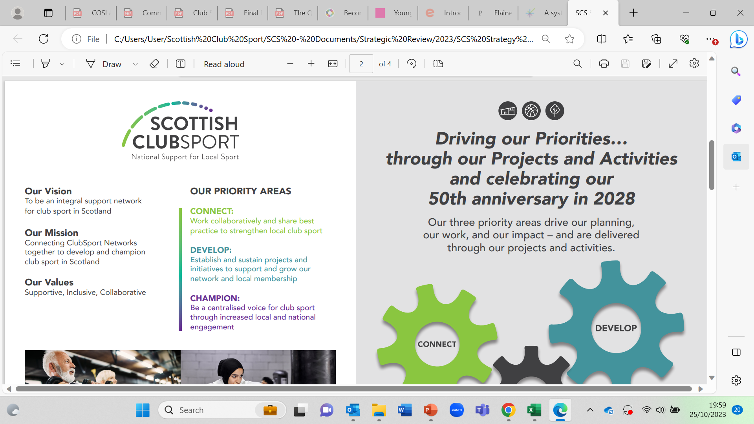
Scottish ClubSport Strategy
2024-28

Slide 3
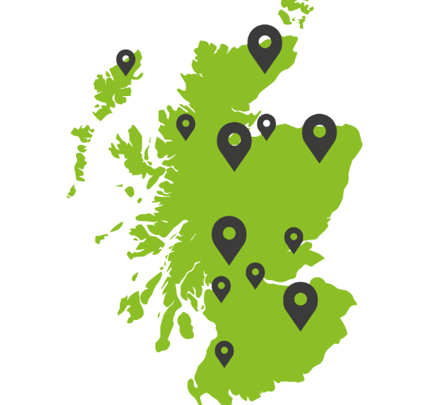
Our Members and Wider-Network
24 Sports Councils & ClubSport Networks
Approx. 1500 sports clubs affiliated locally from 70+ sports
101,000+ individual members
Covering 15 Local Authorities
14 Associate Members
Governing Bodies
Charities
National Organisations

Slide 4
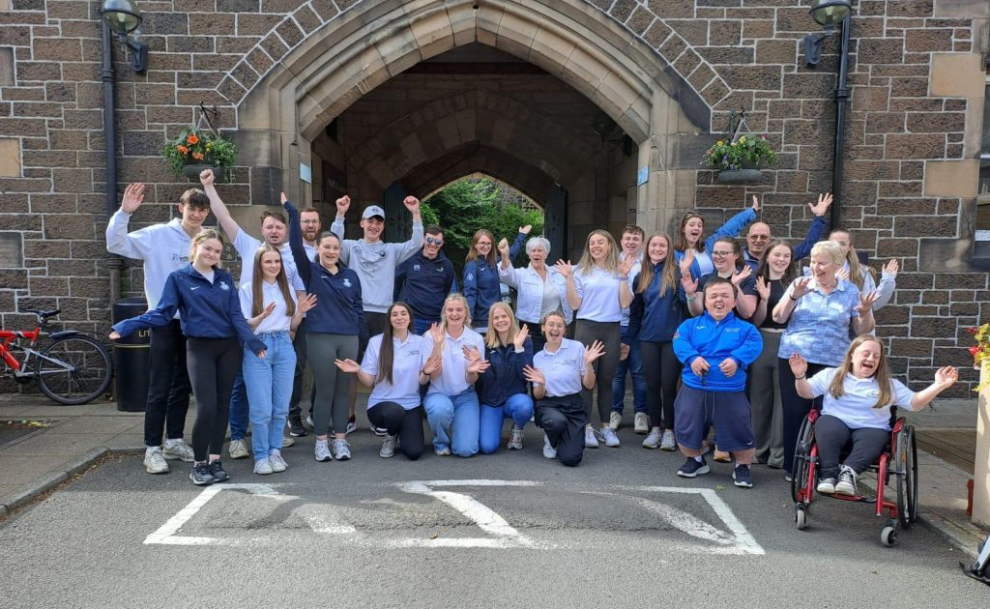
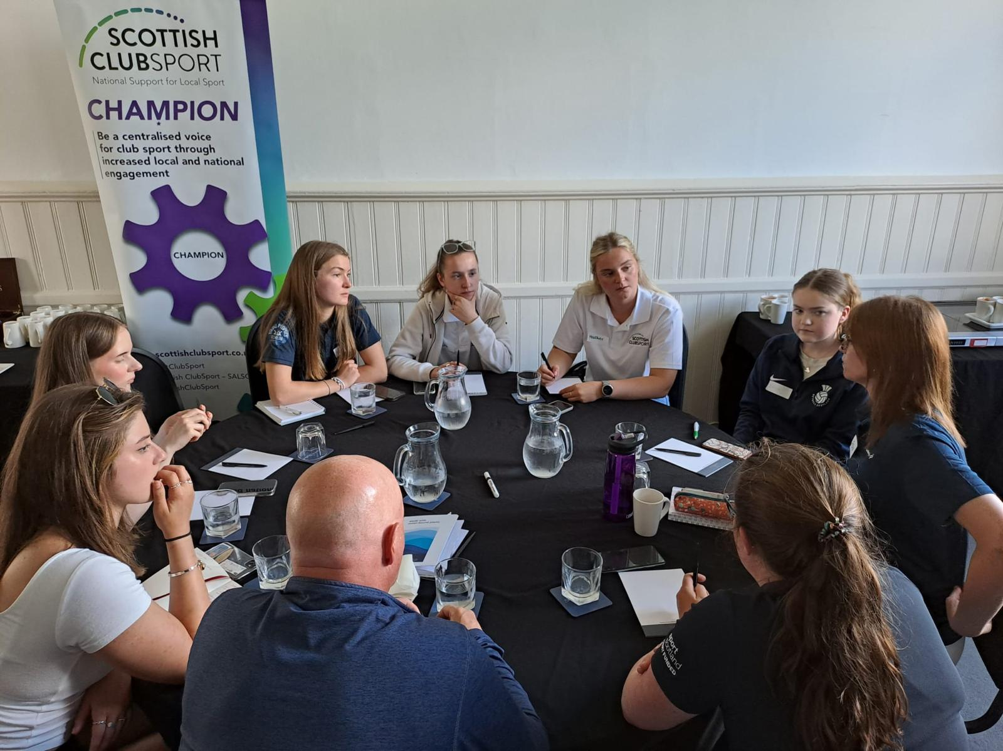
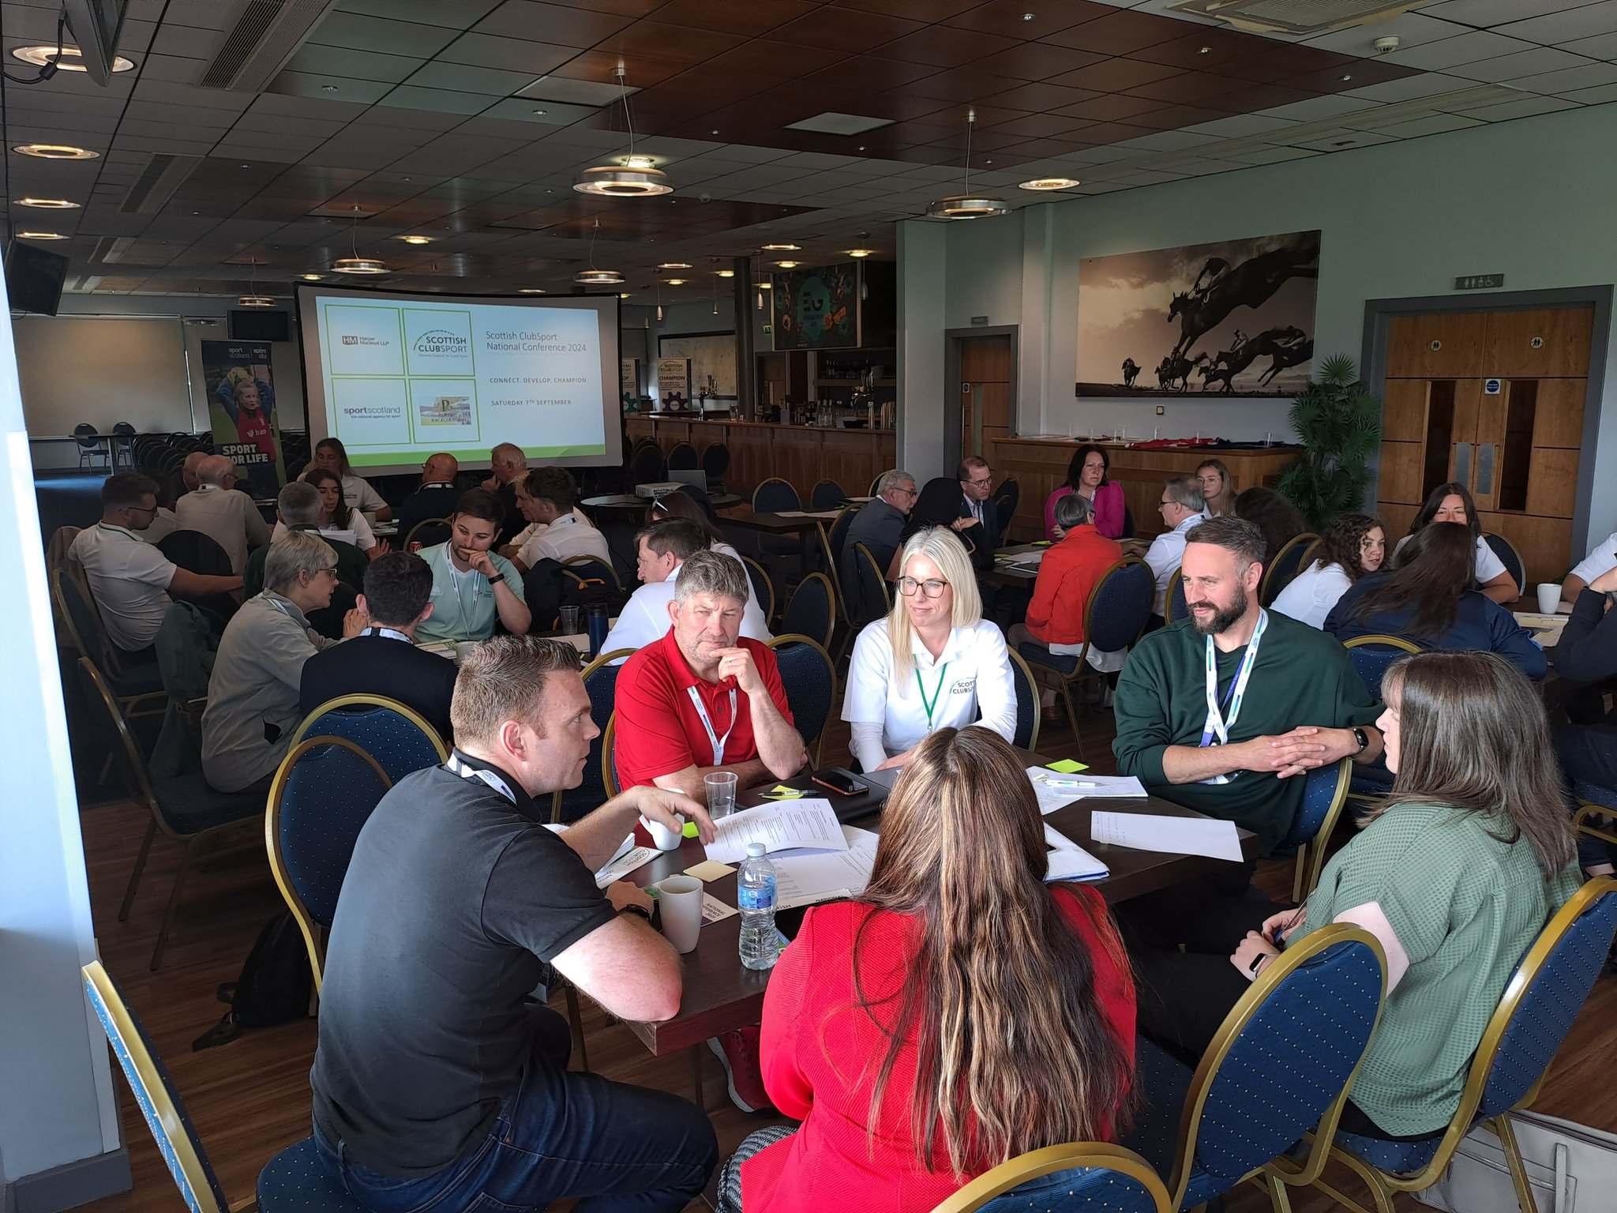
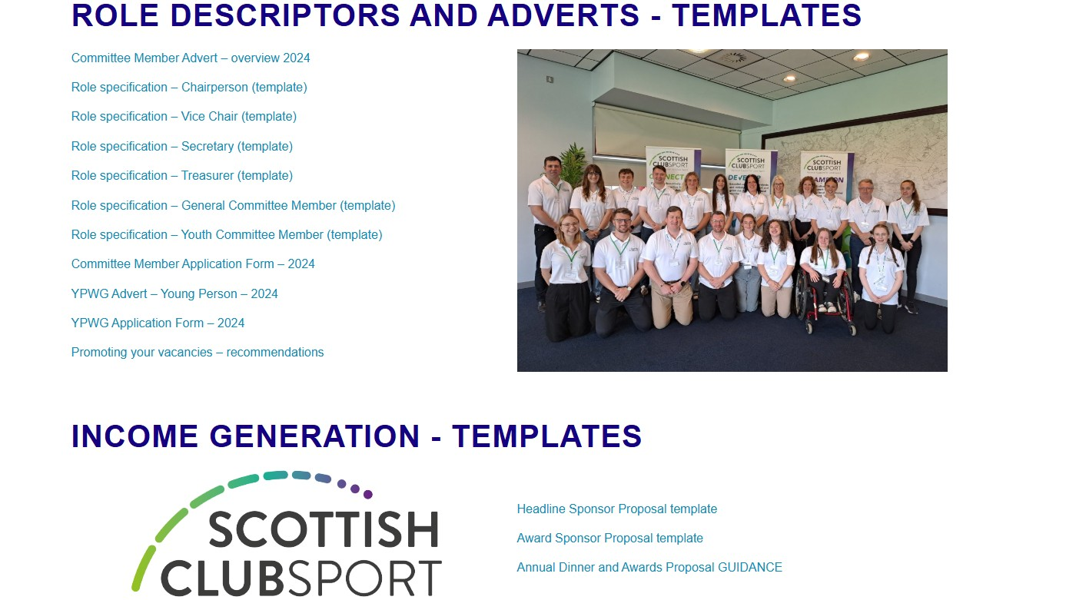
Some of our Highlights
Young People’s Working Group (YPWG) providing support
Connect with local and national partners
PVG Consultation, Forum Session and Guidance
Volunteer & Committee Guidance
  Recruitment and retainment documents
  Income Generation
  EDI Data Gathering

Slide 5

SCS 2026-27 Objectives
Connect with local and national members, partners and networks, identifying regularity and purpose
Develop a strong and sustainable local ClubSport network by strengthening local infrastructure
Champion our work and local network through improved data capturing and information sharing process

Slide 6
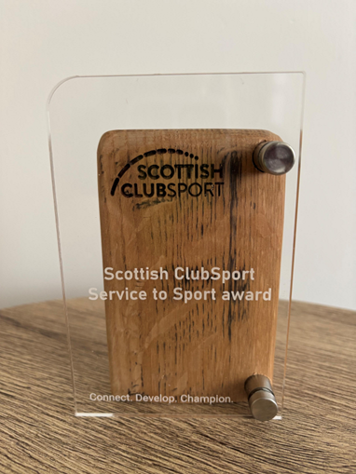

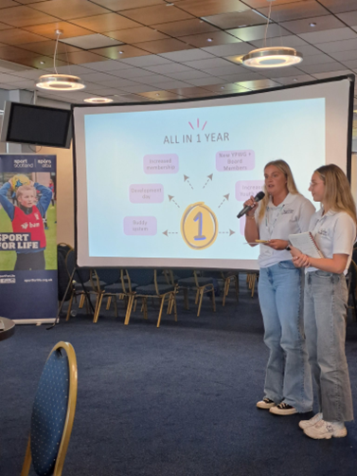

Plans for 2026-2027 include:
New Board Structure implemented
New resources – EDI and Induction (for committees)
Ongoing National Committee Forums / Workshops
Young People’s Working Group
Examine, consolidate our reach & our ‘space’ within the ever-changing sporting landscape
Support the network with great examples – case studies etc.

Slide 7

Sport | Space
Athletics | Bridgeton Community Learning Campus
Archery | Calton Heritage & Learning Centre
Badminton | Glasgow Central Mosque
Basketball | YMCA Tollcross
Cycling | Helenslea Community Hall
Handball | Heart of Scotstoun
Judo | The Halliday Foundation
Pickleball | Roystonhill Community Hub
Table Tennis | Glasgow the Caring City

Slide 8
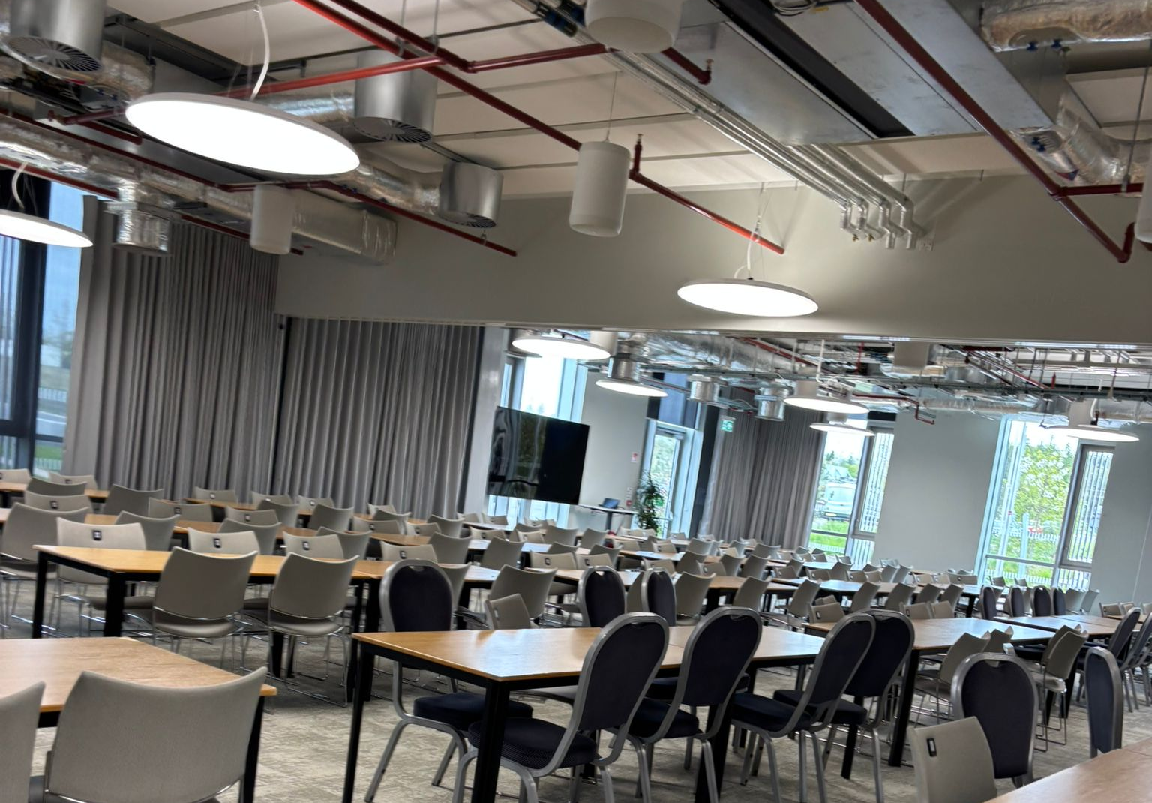
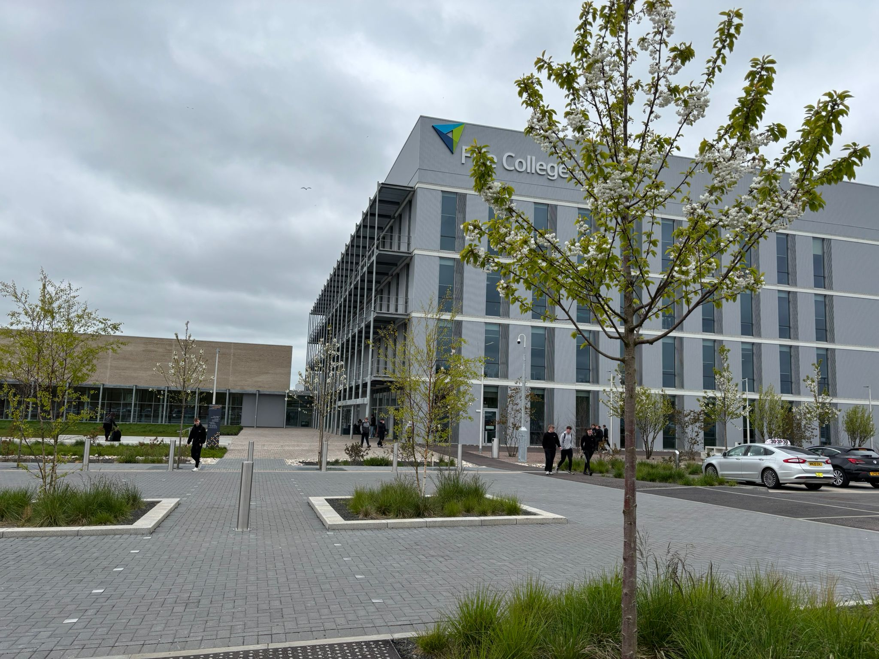
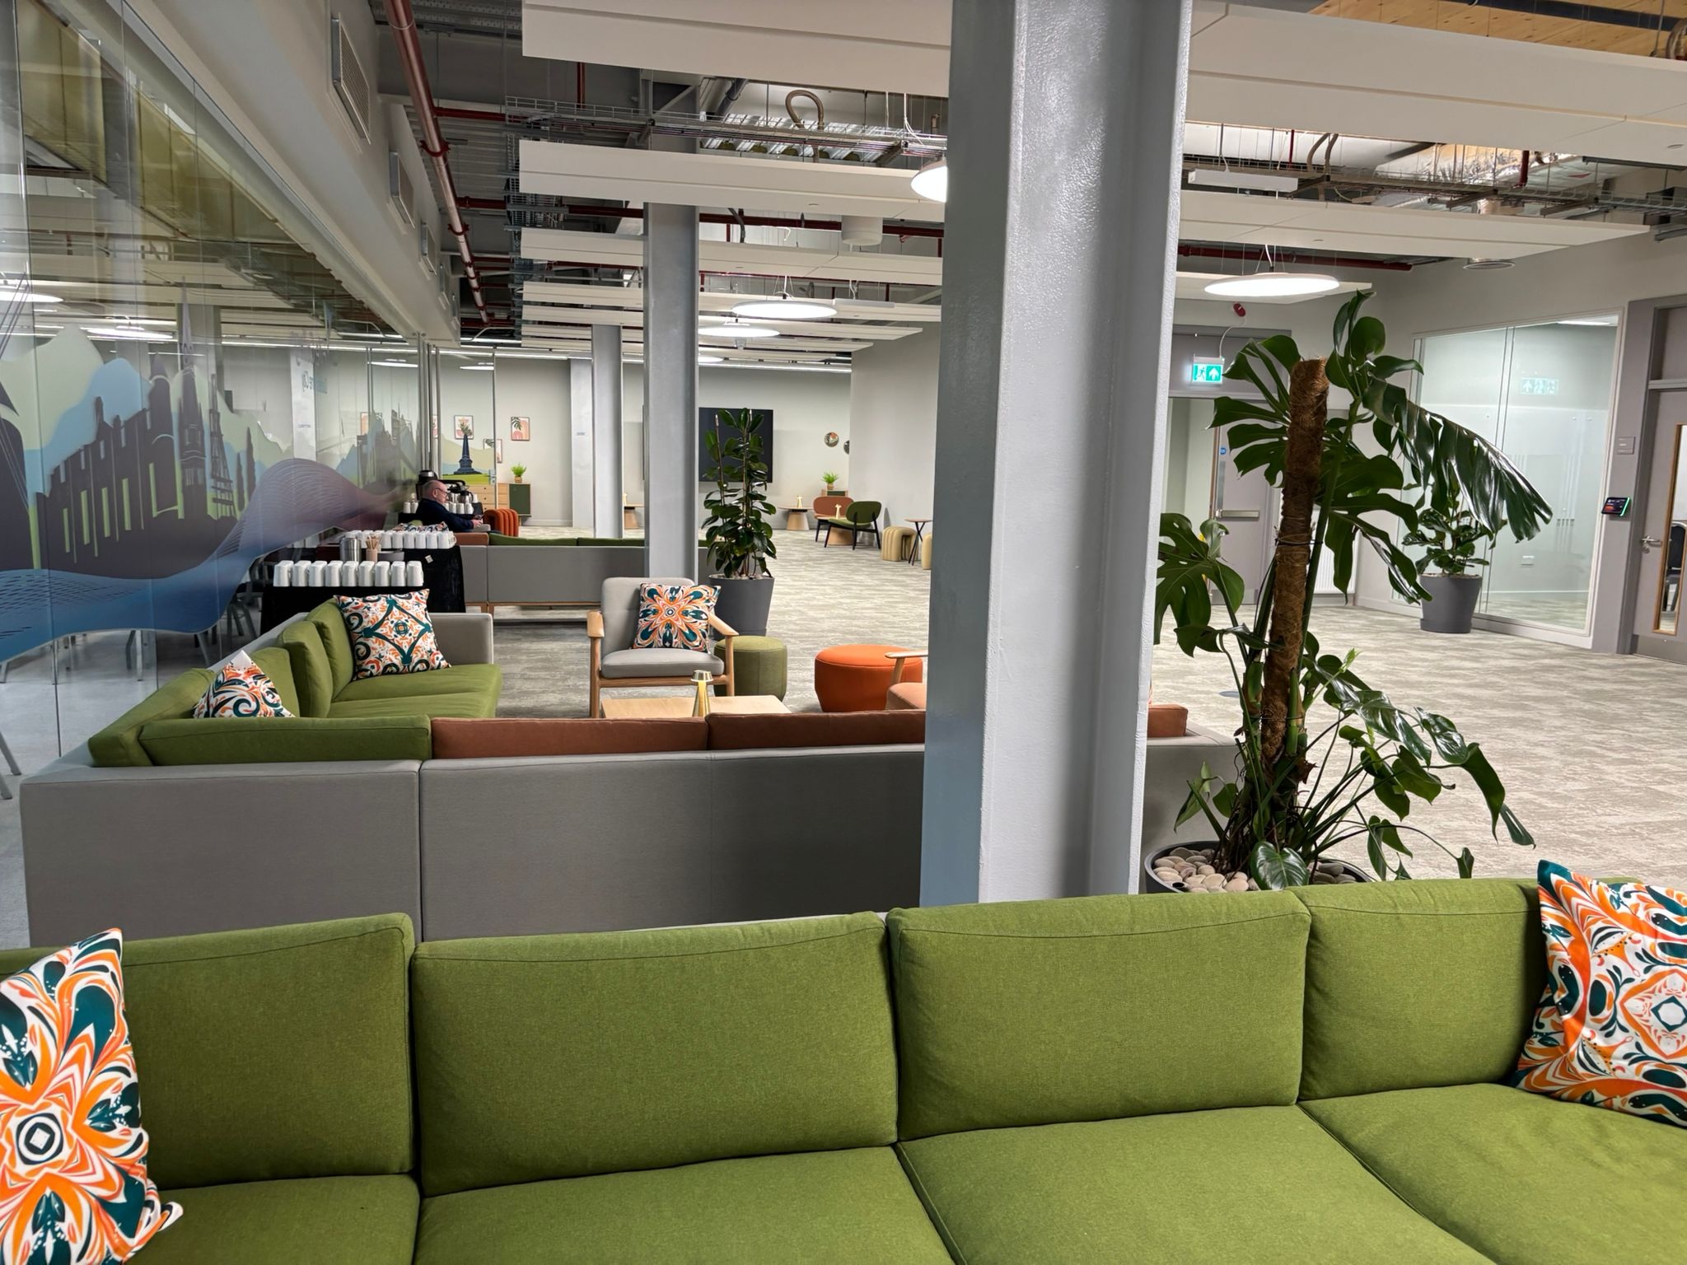
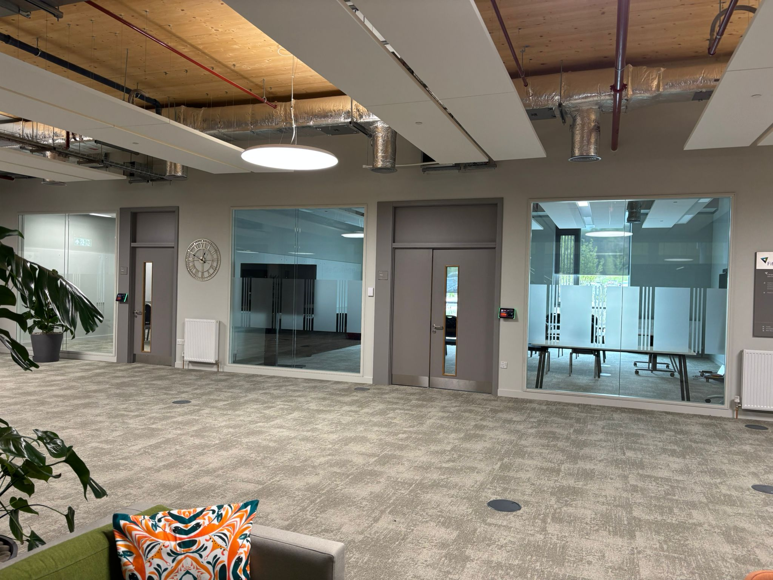
SCS Conference, AGM & Network Awards Dinner
Saturday 5th September 2026
Carnegie Conference & Events Centre, Fife College, Dunfermline
Supporting the Future of Grass-Roots Sport
Building sustainable, connected and resilient sporting communities
Looking at 3 key areas:
  Legacy
  Sustainability
  Engagement
With best practice examples woven throughout the day!

Slide 10
Highlights Continued
Volunteer & Committee Guidance
  Recruitment and retainment documents
  Income Generation
Stakeholder Mapping and new engagement
EDI Director & Moving to Inclusion
Sustaining Partnerships – Harper MacLeod, SAIP and Actify
Notes:
SS Target - Support ClubSport Networks to connect with local and national partners (sporting and nonsporting)and work effectively to support local clubs and volunteers - CONTINUED:
Volunteer & Committee Guidance
recruitment, retainment and income generation.
Included role descriptors, template adverts, guidance for promoting and template sponsor forms for awards evenings
Income Generation – proposal templates and guidance
Stakeholder Mapping – new engagement e.g. COSLA – meetings with Jillian Gibson, where we fit into the overall sporting system
SS Target - Support ClubSport Networks to widen access and reduce inequalities in sport and physical activity from underrepresented individuals.
EDI Director appointed
Representation at LEAP Sports etcc
Moving to Inclusion
Action plan agreed at board meeting in May 2025 – key piece of work for EDI director and Liza

