Slide 1
ALL IN

Slide 2
All In is the national call to action for the Glasgow 2026 Commonwealth Games.
We're putting the call out to schools, communities, sport and voluntary organisations, and businesses across Glasgow and Scotland to get involved, have some fun, and celebrate the Games in their own altogether brilliant way

Slide 3
What is All In?
Glasgow 2026 isn't just for Glasgow; it's Scotland’s Games.
All In is about everybody across the country showing their pride in the biggest sporting event in the country returning this year.
Inclusive, accessible and led by local communities, All In gives organisations across Scotland the tools to create their own activities, events and celebrations. Bringing people together and building excitement ahead of an incredible summer of Scottish sport this year.
All In helps drive local impact across Scotland; boosting skills, wellbeing, physical activity and local pride, while supporting businesses and strengthening the visitor economy as excitement builds towards the Games.
All In is Glasgow 2026’s collective countdown. A nationwide movement inviting everyone to gather and play a part in something unforgettable, unmissable and altogether brilliant

Slide 4
Why register for All In?
BRANDING: Organisations can utilise the All In brand name and logo in the promotion of their event, project or activation.
PROMOTION: Projects and activations will be promoted on list.co.uk. Some projects may be selected to feature in social media content.
ASSETS: organisations will receive a digital activation toolkit containing All In logo files, brand guidelines, poster, bunting and digital templates.
PUBLICITY: From time to time, details about some projects will be shared in the media to raise awareness of the All In programme and projects.
NETWORK: All In registered organisations will receive regular updates, be invited to networking events and workshops, and have access to additional development opportunities.

Slide 5
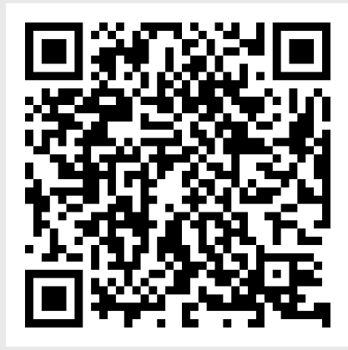
Want to be All IN ?
visit – Glasgow2026/BeAllIN

Slide 6
THANK YOU

